Slide 1

Activating Extension's Network for Community Engagement​
Notes:
In February of 2022, NE Extension hosted the Amplify Engagement Conference that brought together Extension professionals from across the state, professors at UNL, and community partners. The goal was to come together to learn about key issues facing our state and create partnerships to contribute to the public good. We spent the first day learning together and then the second day we toured campus facilities and learned about on-going engagement work.

Slide 2
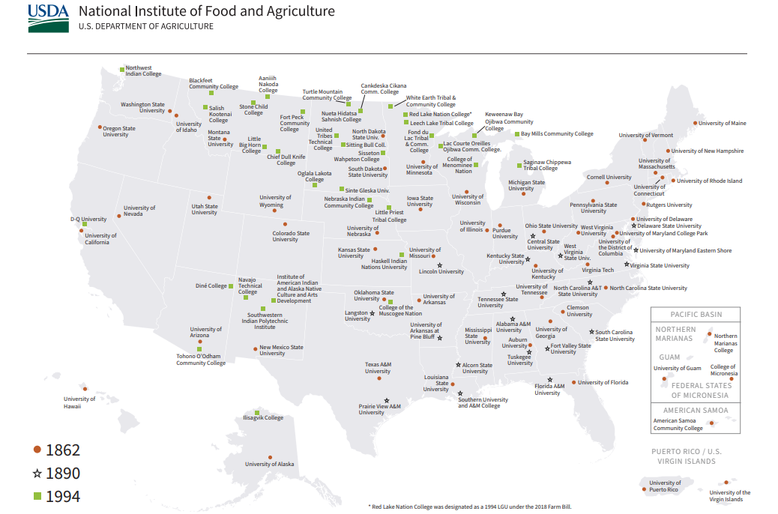
Notes:
Short description of land-grant institutions and Extension.

Slide 3
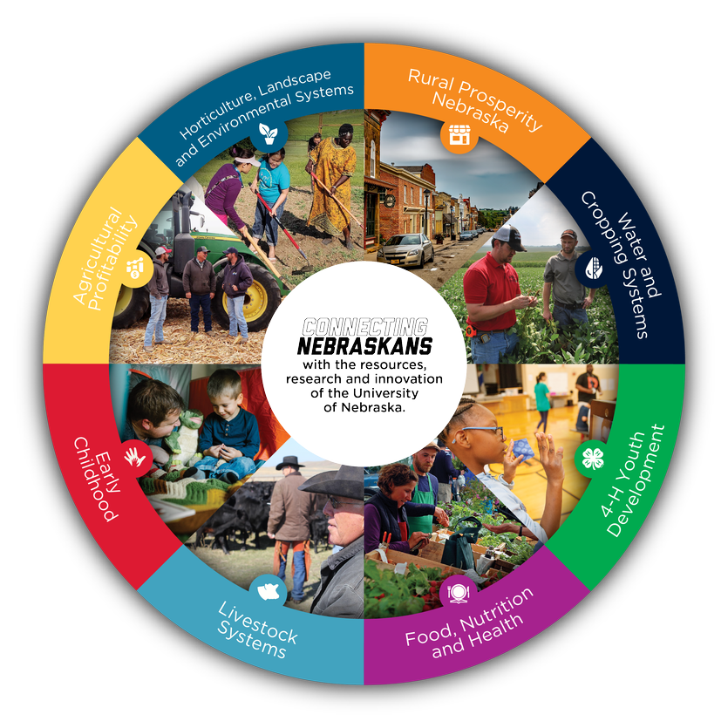
Notes:
We currently have 8 programming areas and have Educators and Assistants strategically located across the state in each of these areas. Some staff are located within counties while others are designated to work state-wide.
The program areas are: Ag Profitability; Horticulture, Landscape, and Environmental Systems; Rural Prosperity Nebraska; Water and Cropping Systems; Early Childhood; Livestock Systems; Food, Nutrition and Health; and 4-H Youth Development.
There are Program Area Leaders who focus on driving the statewide direction of the programs.

Slide 4
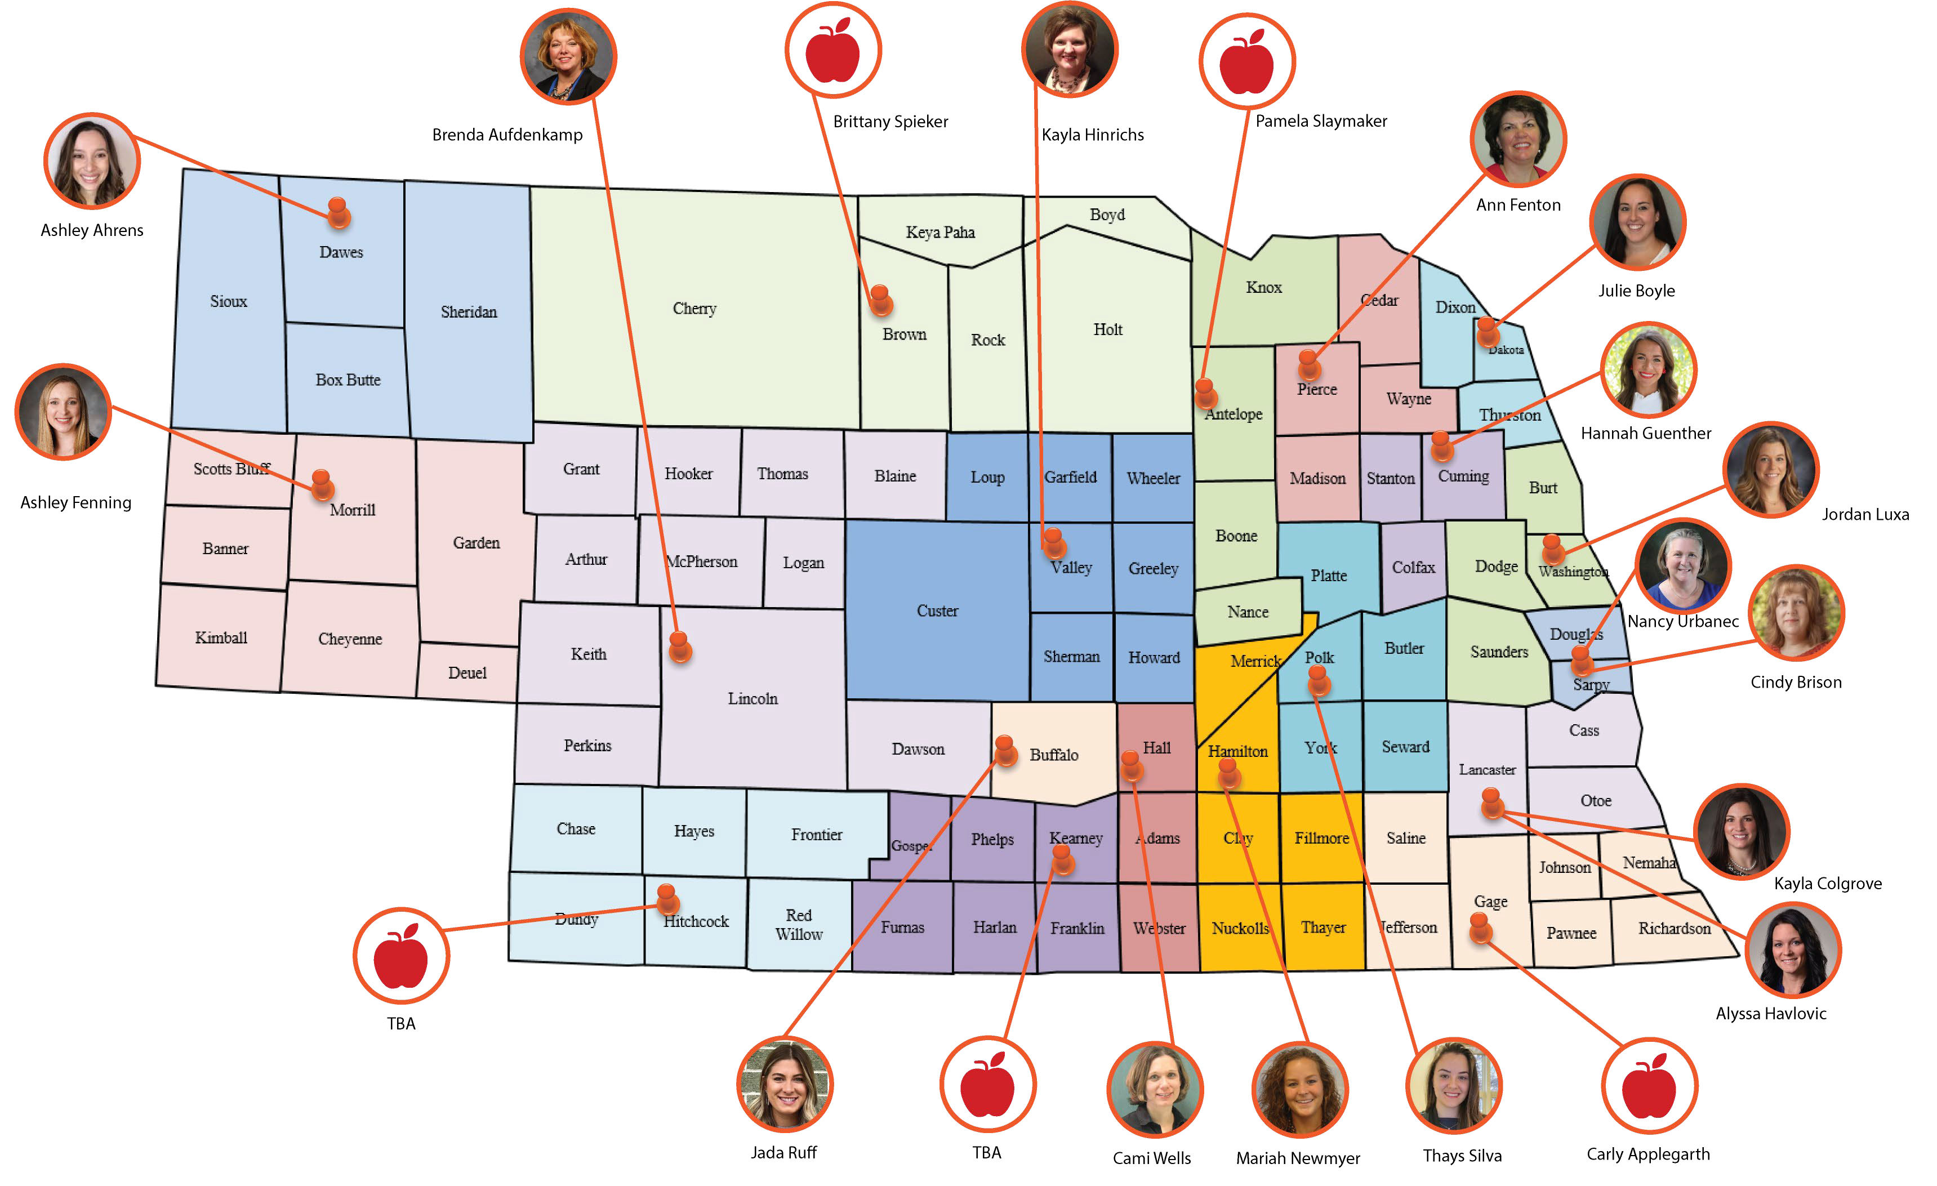
Food, Nutrition, Health

Slide 5
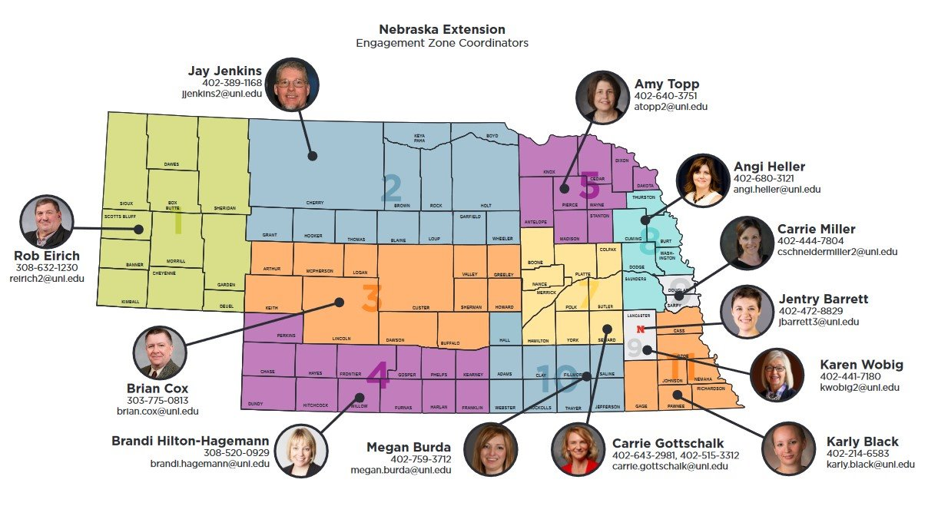
Notes:
Nebraska Extension has 11 outstate Engagement Zone Coordinators who live, work, and play in the communities they serve and are focused on being very well connected. In fact, outstate Engagement Zone Coordinators have a 60% apportionment focused on engaging with community stakeholders, leaders, local politicians, and community members to understand what is happening in their communities. As they are meeting with community leaders, they are looking for ways that their community could engage with university.
Additionally, there is 1 on campus Engagement Zone Coordinator for the UNL community. The campus EZC is 100% focused on engaging with deans, departments, and individual faculty.
This structure has also allowed for a freer flow of information to and from communities to UNL faculty and research.

Slide 6
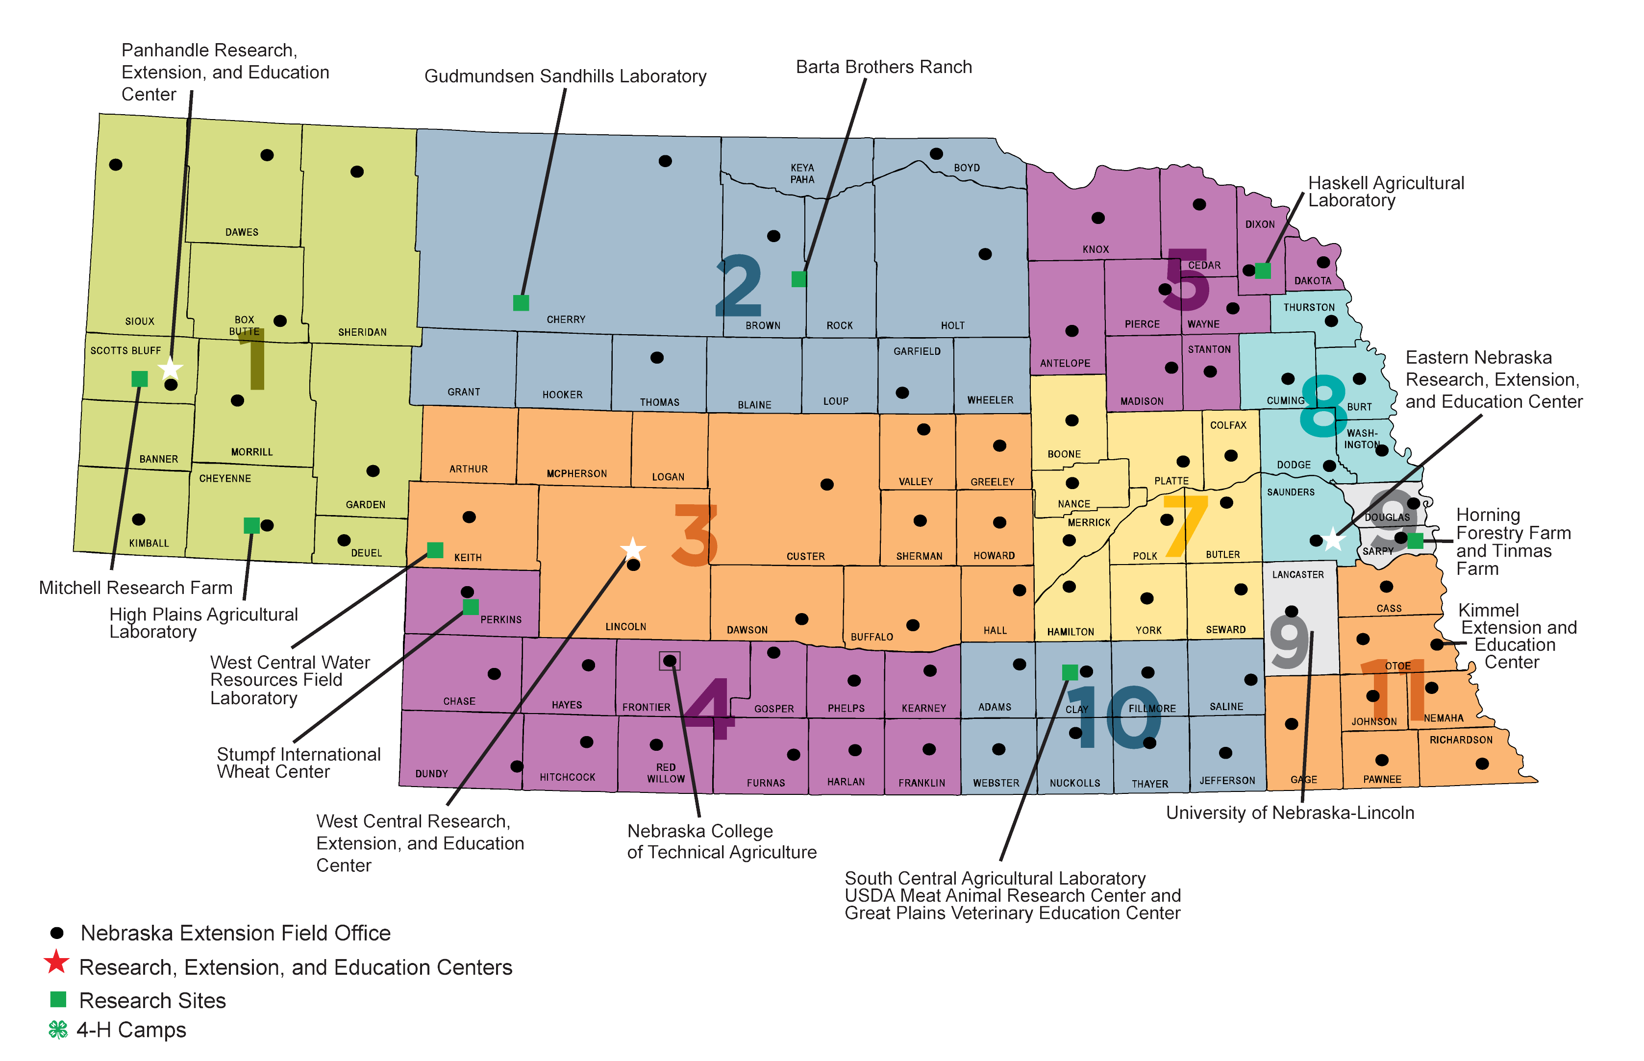
Notes:
It is important to note that every University system looks different. Here at Nebraska Extension, we have around 360 Extension experts on campus and in the counties who connect with 1.9 million Nebraskans annually. This map highlights the Extension county offices, Research and Extension Centers, and Research sites which make up Nebraska Extension. We currently have 83 county offices which serve all 93 counties of the state.

Slide 7
Extension's greatest asset: Local relationships and infrastructure.
Include Extension representatives on engagement work groups and committees.
Ask for feedback (early!) from Extension faculty when developing project ideas that will involve or impact communities.
Look for opportunities for Extension to lead or play a role in the broader impact activities on grant projects. They are experts in curricula development, evaluation, and change management.
Extension can organize community partners for listening sessions and tours of communities.
Alert the local Extension office when you are traveling to their community, they want to help you connect to the right people and give local context.
Extension doesn't just happen, make sure to provide resources to Extension when they provide resources to you.

Slide 8

Making a difference

